Slide 1
Entity Framework
- Iqan

Slide 2
Content
Introduction
History
Code first approach
Database first approach
Model first approach
Some Entity Framework 6 features

Slide 3
Introduction
What is Entity framework?
An Object/Relational Mapping (ORM) framework that enables developers to work with relational data as domain-specific objects, eliminating the need for most of the data access plumbing code that developers usually need to write
An enhancement to ADO.NET that gives developers an automated mechanism for accessing & storing the data in the database.
Other options:
Custom DbAccess class
Dapper
LINQ to SQL
Nhibernate, etc.

Slide 4
History
EF Version | Introduced Features
EF 3.5 | Basic O/RM support with Database First approach.
EF 4.0 | POCO Support, Lazy loading, testability improvements, customizable code generation and the Model First approach.
EF 4.1 | First to available in the NuGet, Simplified DBContext API over ObjectContext, Code First approach. EF 4.1.1 patch released with bug fixing of 4.1.
EF 4.3 | Code First Migrations feature that allows a database created by Code First to be incrementally changed as your Code First model evolves. EF 4.3.1 patch released with bug fixing of EF 4.3.
EF 5.0 | Announced EF as Open Source. Introduced Enum support, table-valued functions, spatial data types, multiple-diagrams per model, coloring of shapes on the design surface and batch import of stored procedures, EF Power Tools and various performance improvements.
EF 6.0 - Current release | EF 6.0/6.1 is the latest release of Entity Framework. It includes many new features related to Code First & EF designer like asynchronous query & save, connection Resiliency, dependency resolution etc.

Slide 5
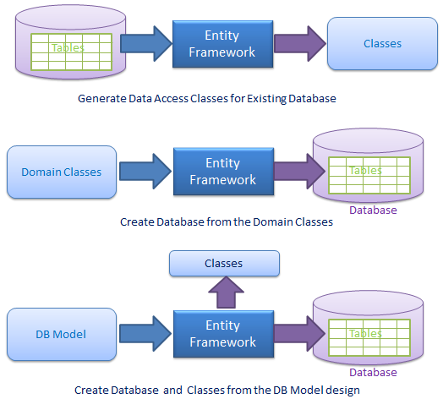
Different approaches for EF

Slide 6
Code first
Class
Database
Entity Framework

Slide 7
Database first
Database
Class
Entity Framework

Slide 8
Model first
Database
Model (design using UI)
Entity Framework
Class

Slide 9
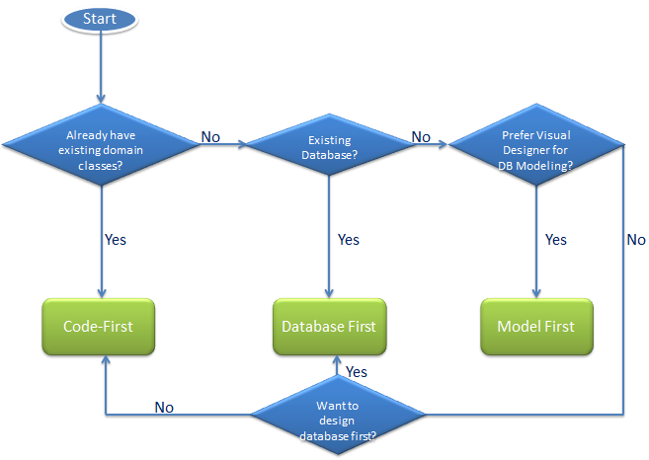
How to decide?

Slide 10
Demo
Source code available on GitHub

Slide 11
EF 6 Features
Async query and Save
Code-based configuration
Db command logging
Command interception
Transaction support
AddRange in DbSet
Conventions
SP mapping
Index attributes

Slide 12
Thank You ☺

